Slide 1
MyBank
Banking Application
XZY
Notes:
1

Slide 2
Table of Contents
Brief description of the case study/problem statement
Objective of the project
Tools & Technologies
High-level architecture
Key components or features
Flowchart and User Flow
Tools Description
Implemented Project Structure
Screenshots of implementation (User & Admin)
Monitoring and Testing tools
Challenges faced and how they were addressed
Key Takeaways
Github Link
2
Notes:
2

Slide 3
Problem Statement
Traditional monolithic banking systems cause tight coupling between users, accounts, and loans, making feature evolution difficult. Manual cross-checks lead to frequent errors and inefficiencies. Failures in one module can impact the entire system due to limited fault isolation. Hence, there is a pressing need for a secure, modular, and scalable solution that allows independent evolution of services without system-wide impact.
Objectives
Modular Microservices Architecture Decouple users, accounts, loans, and admin into independently deployable services for better scalability and maintainability.
Automated Loan Lifecycle Streamline the full loan process (apply → approve → disburse → repay) with an audit trail for transparency and compliance.
Centralized Observability & Admin Oversight Enable real-time monitoring, logging, and user/loan visibility for administrators through a unified dashboard.
Resilient & Scalable System Design Leverage service discovery, inter-service contracts, and targeted scaling of high-traffic services like loans and accounts.
3

Slide 4

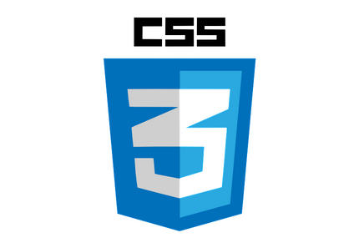








Tools & Technologies Used
Frontend:
Backend:
IDE:
Database:
Monitoring /Testing and Streaming
4

Slide 5
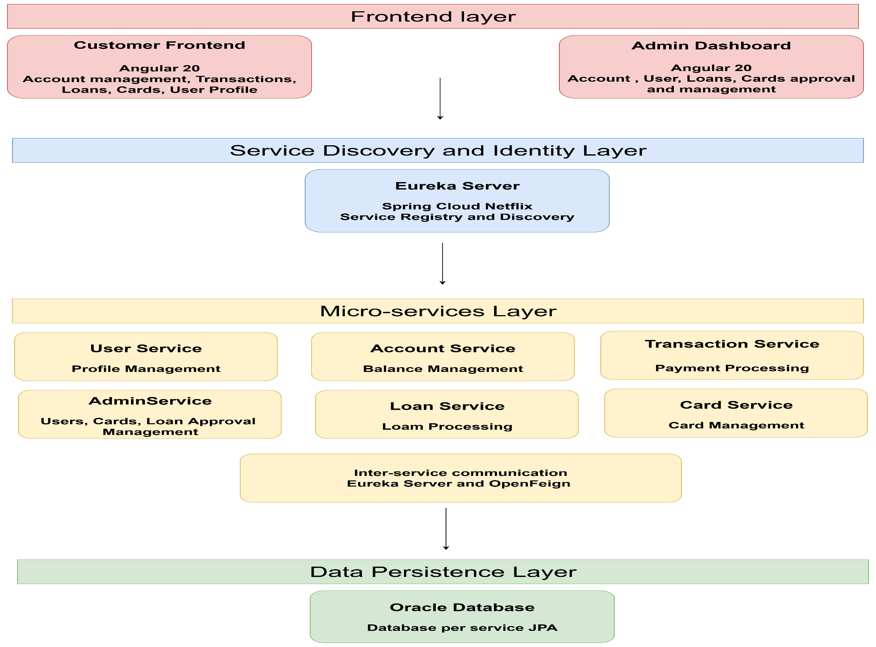
High Level Architecture

Slide 6
Architecture Flow & Key Features
Request Flow : Frontend → user-service / loan-service / admin-service / card-service → account-service / transaction-service → Databases
Examples:
User + Account: Client → user-service → account-service → Aggregate response
Loan Lifecycle: Apply, Approve, Disburse, Repay → loan-service → transaction-service
Card Operations: Requests handled via card-service
Admin Aggregation: Admin portal → admin-service → calls user-service, loan-service, & card-service
Service Discovery: Eureka enables dynamic registration and discovery of all microservices , API Gateway routes requests dynamically based on service availability
Communication: Feign for critical operations
Monitoring: Postman for testing, monitoring and streaming

Slide 7
Key Components and features
Admin Role
For bank employees (internal staff)
Access via admin-service (/admin/... endpoints)
Responsibilities:
Approve/reject KYC
Sanction loans
Manage users
Has full system access and visibility across services
6
Notes:
3

Slide 8
Key Components and features
Customer Role
For bank customers (end-users)
Access via loan-service, user-services, etc.
Capabilities (if KYC verified):
Manage accounts
Perform transactions
Apply for loans
View personal data
Apply for cards(debit and credit), set and change PIN, Set the limit usage for cards
Access is limited to own data only
Can repay for loans based on the repayment schedule
6
Notes:
3

Slide 9
Key Technologies in Our Microservices Architecture
Spring Cloud Ecosystem
Netflix Eureka (Service Registry)
Eureka-server enables dynamic service registration/discovery
All microservices (loan, admin, user, etc.) act as Eureka clients
OpenFeign
Declarative REST client for inter-service communication
Simplifies HTTP calls between microservices
Spring Cloud LoadBalancer
Client-side load balancing for Feign/RestTemplate calls
Replaces Ribbon for load distribution

Slide 10
Key Technologies in Our Microservices Architecture
Spring Cloud Ecosystem
Spring Data JPA + Hibernate ORM
DeclarativeUsed for entity mapping and database access
Abstracts complex SQL via repositories
Oracle Database (OracleDialect)
Primary database engine; Oracle 19c-style configs used
Optimized for enterprise-scale data persistence
Oracle JDBC Driver (ojdbc8/ojdbc11)
Provides connectivity to Oracle DB
HikariCP
High-performance JDBC connection pool
Used as the default DataSource

Slide 11
Key Technologies in Our Microservices Architecture
Code & Configuration Helpers
Lombok
Reduces boilerplate (e.g., @Data, @Builder)
SnakeYAML
Parses YAML configuration files
Testing Frameworks
Spring Boot Starter Test
Combines all testing utilities for Spring apps

Slide 12
Key Technologies in Our Microservices Architecture
Web Layer & JSON Handling
Embedded Tomcat 10.1.x
Bundled web server for running Spring Boot apps
Jackson 2.18.x
JSON serialization/deserialization
Converts Java objects to/from JSON
RestTemplate
Still used internally (e.g., by Eureka clients)
Observability & Logging
Spring Boot Actuator
Exposes health, metrics, and info endpoints
Micrometer
Metrics collection abstraction (used with Actuator)
SLF4J + Logback
Unified logging framework across services

Slide 13
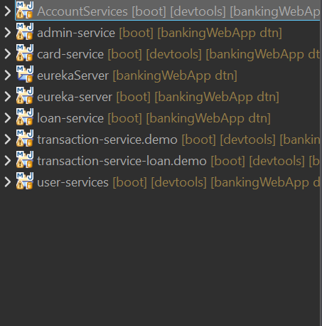
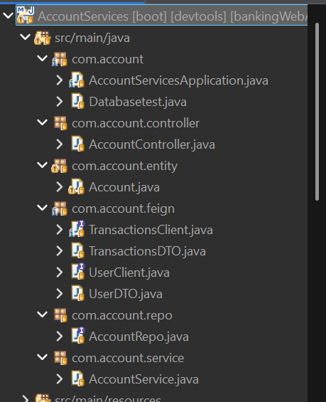
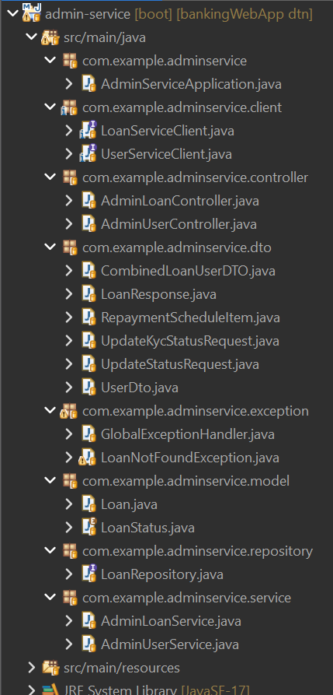
Project Structure
Project Structure
Account Microservice
Admin Microservice

Slide 14
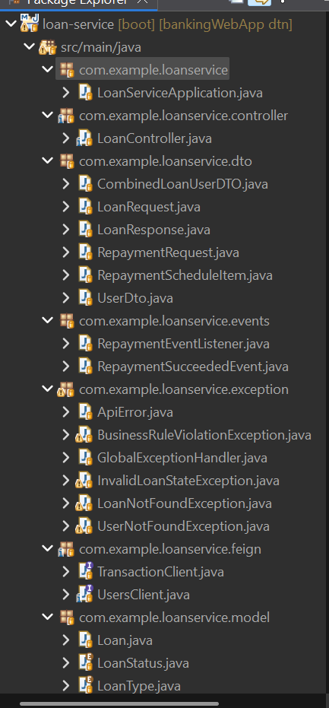
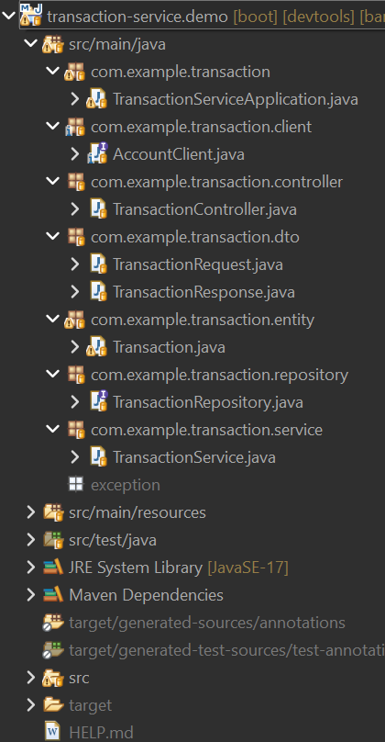
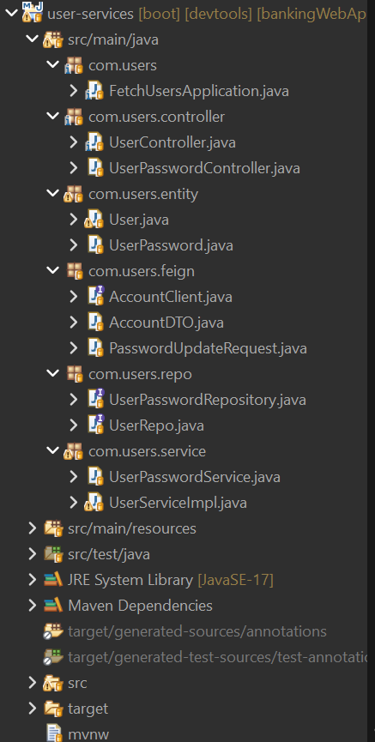
Project Structure
Loan Microservice
Transaction Microservice
User Service
8

Slide 15
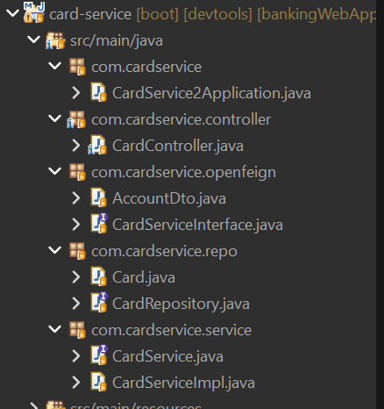
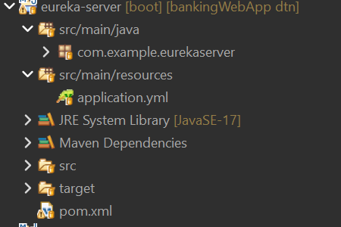
Project Structure
Credit card Microservice
Eureka - Server
8

Slide 16
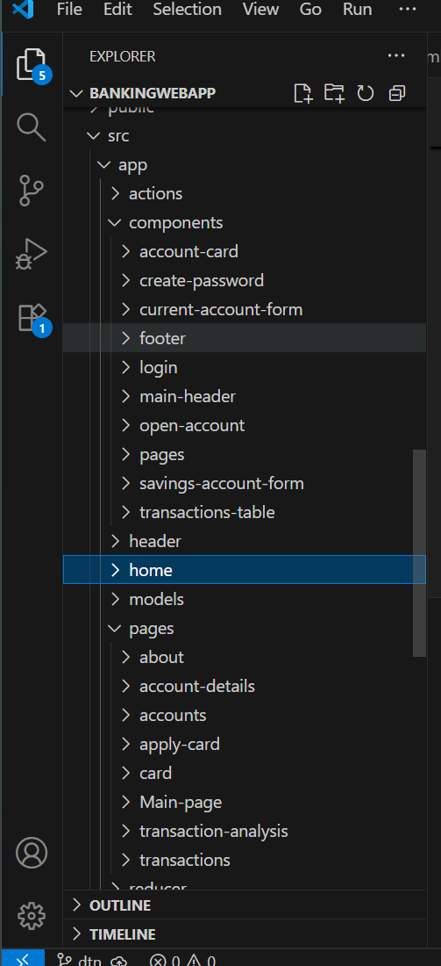
Project Structure
Bank App Frontend
8

Slide 17
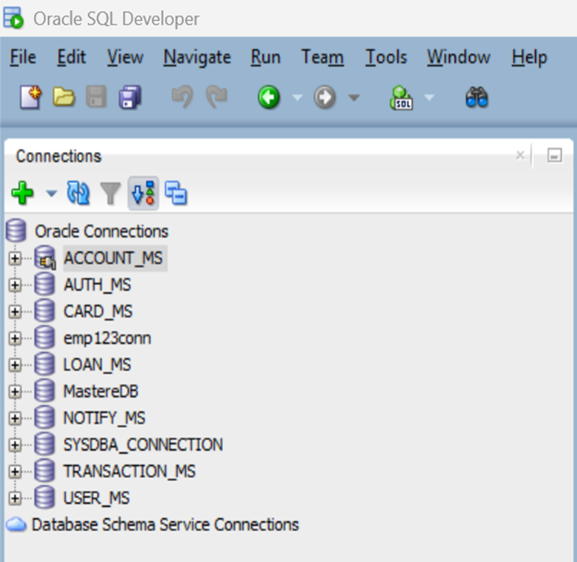
Database
The project employs a polyglot persistence approach, with each microservice managing its own dedicated database schema. Core data is stored in Oracle databases for their proven reliability and strong transactional integrity. The persistence layer leverages JPA and Hibernate to efficiently map Java entities to database tables. This design promotes service independence, reduces coupling, and enhances overall scalability.
9

Slide 18
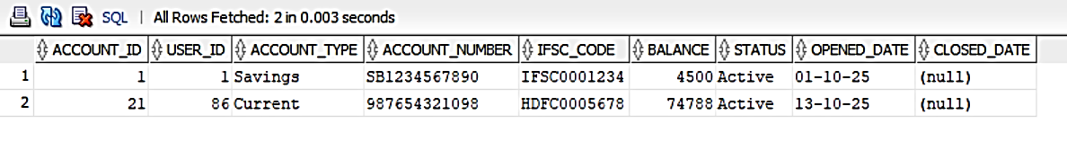
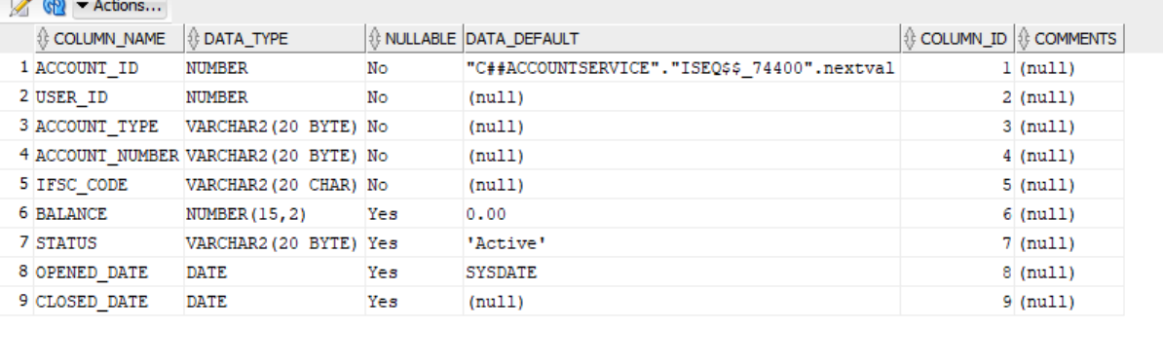
Database Tables
Accounts Database
Accounts Data
Accounts Structure
10

Slide 19
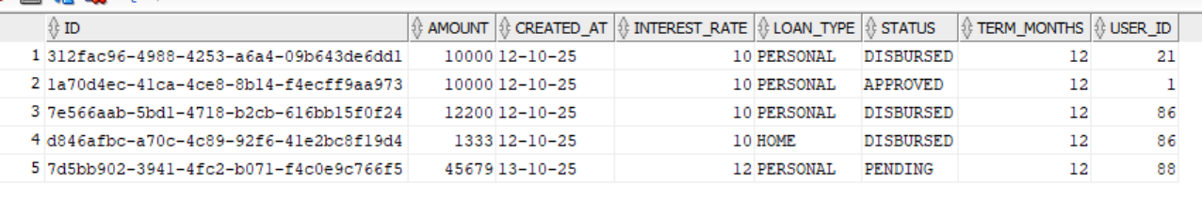
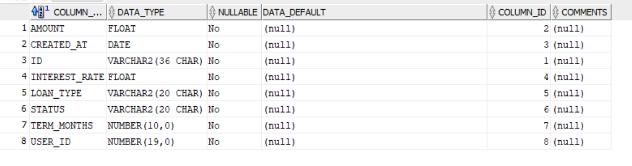
Database Tables
Loans Database
Loans Data
Loans Structure
10

Slide 20
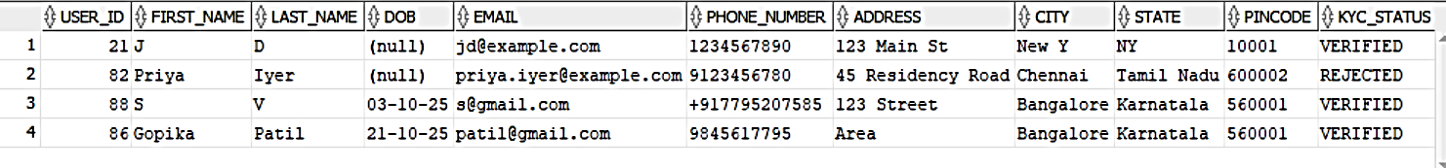
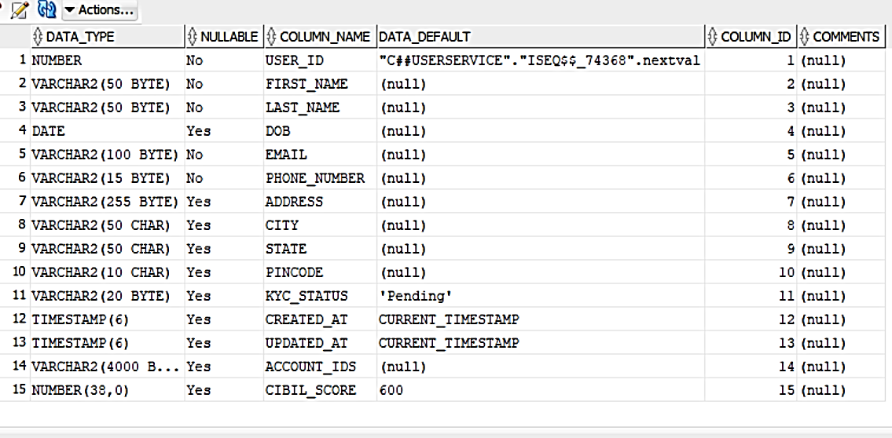
Database Tables
Users Database
Users Data
Users Structure
10

Slide 21
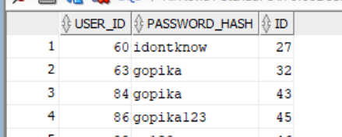
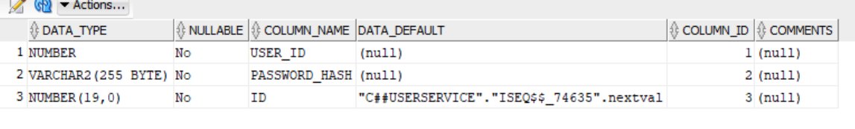
Database Tables
Users Password Database
Users Password Data
Users Password Structure
10

Slide 22
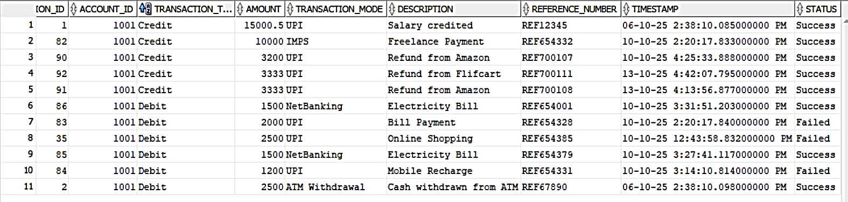
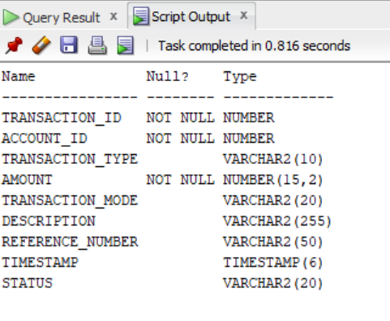
Database Tables
Transactions Database
Transactions Data
Transactions Structure
10

Slide 23
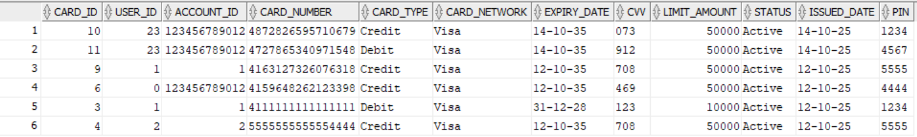
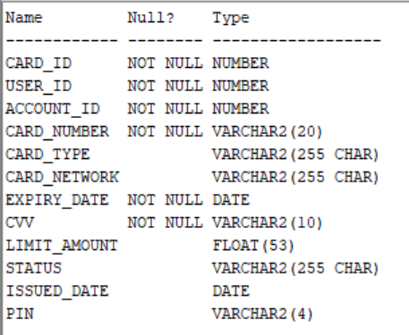
Database Tables
Cards Database
Cards Data
Cards Structure
10

Slide 24
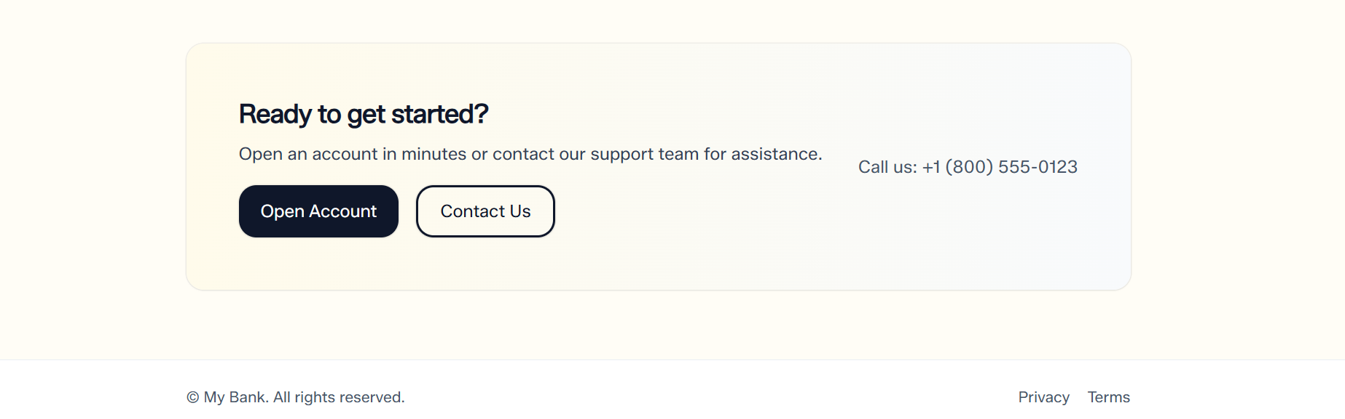
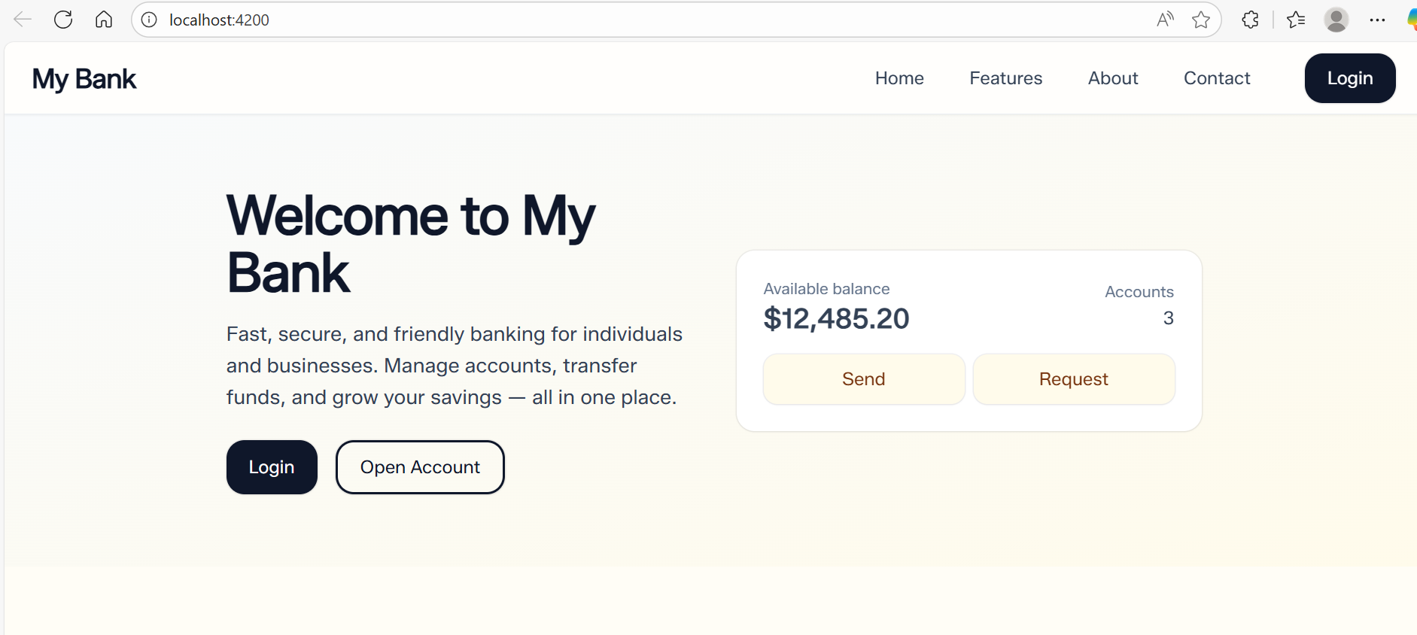
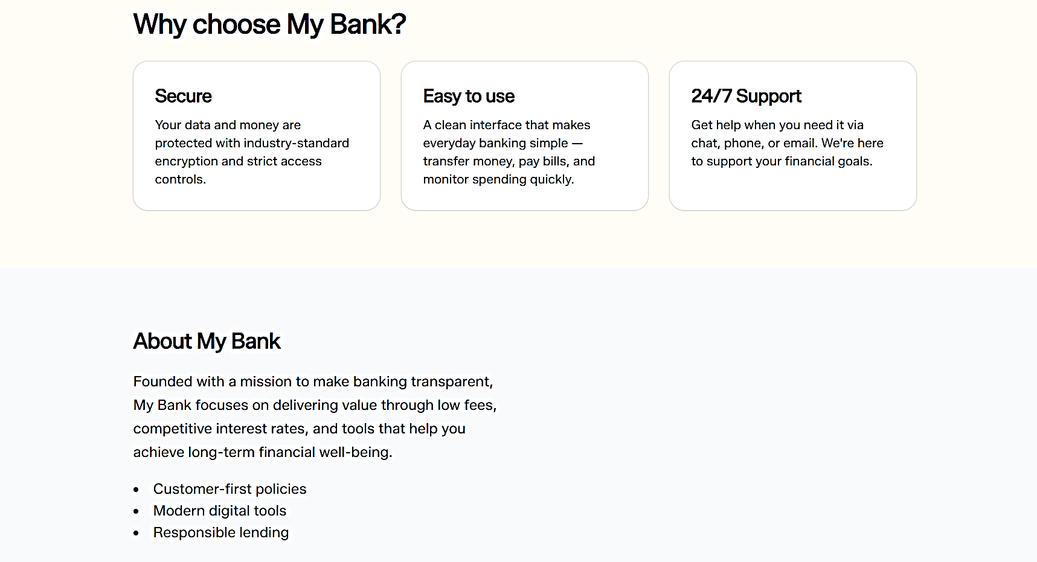
Web Application Screen (Landing Pages)
14

Slide 25
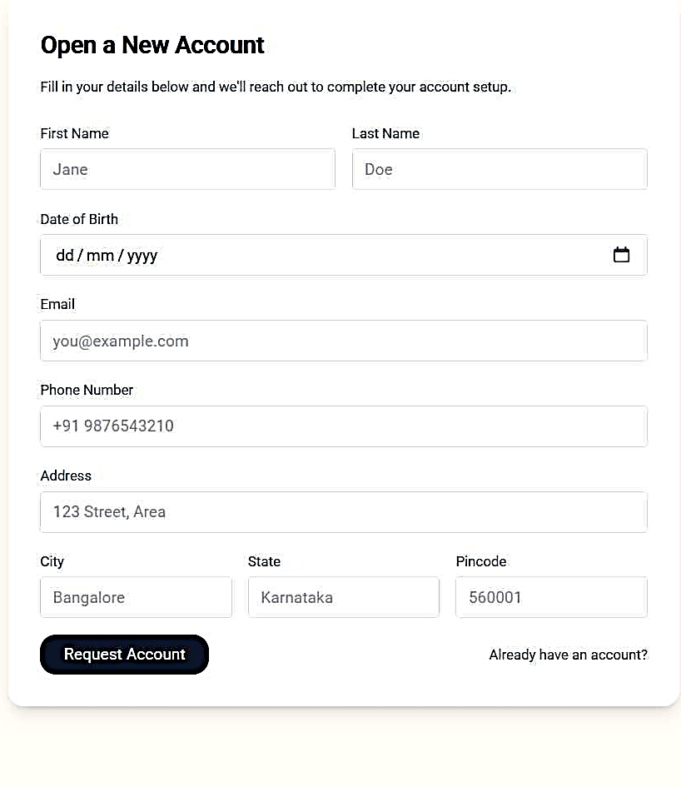
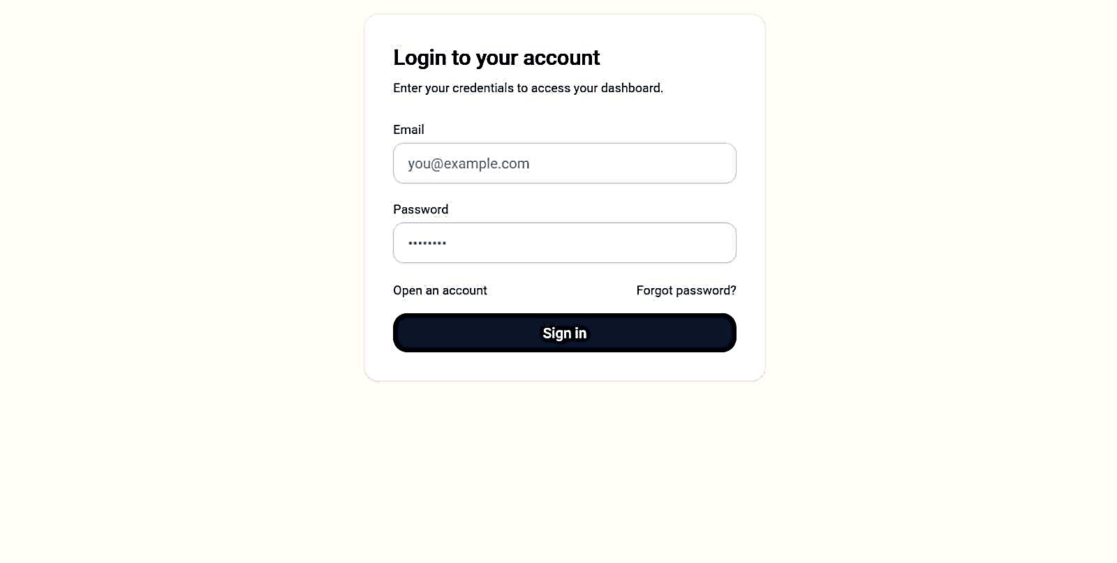
Web Application Screen (User )
Login
Register a New User
14

Slide 26
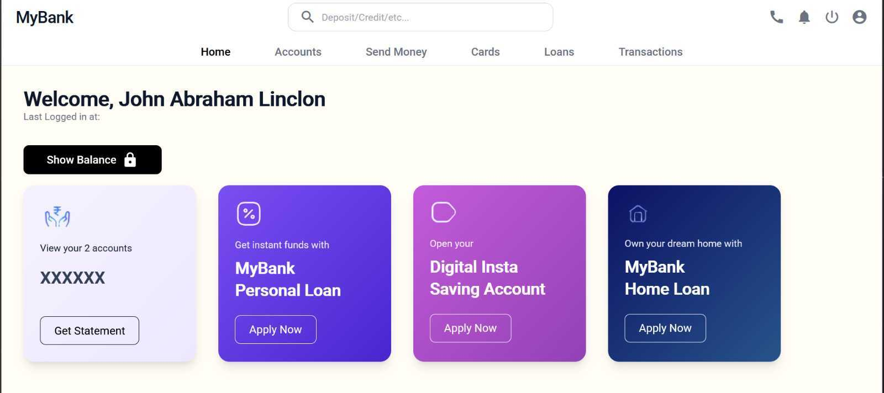
User Dashboard
15

Slide 27
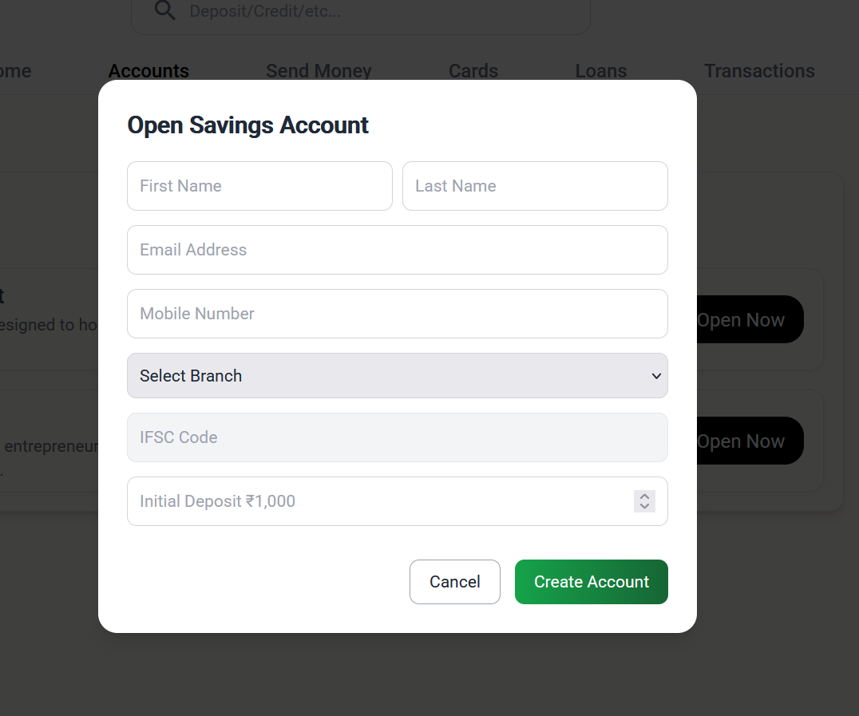
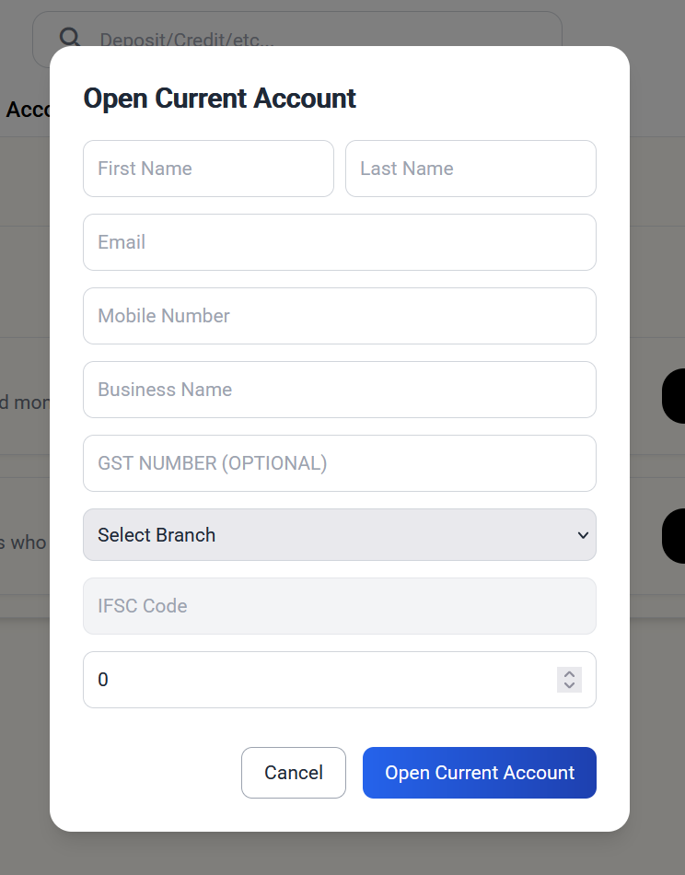
Account Creation Screen
Savings Account Creation Page
Current Account Creation Page
14

Slide 28
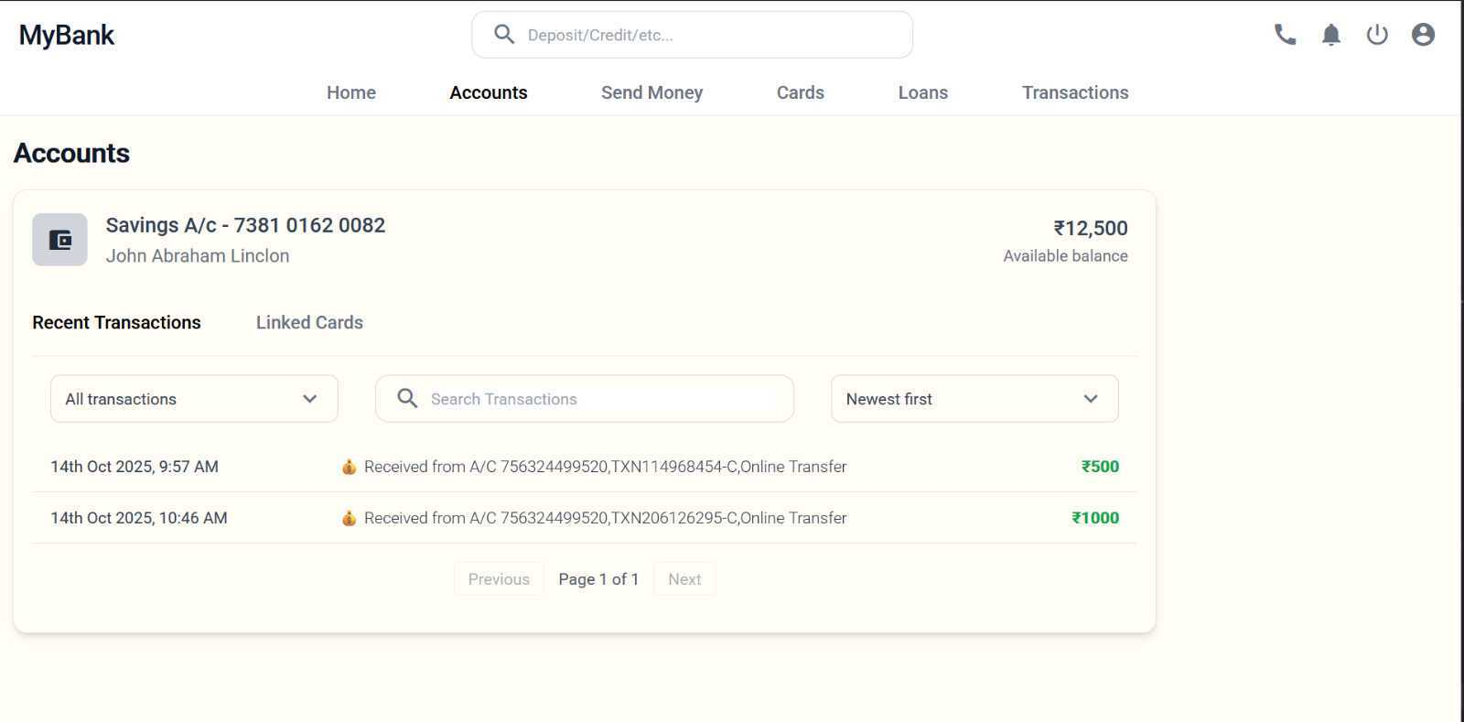
Accounts Details Page
15

Slide 29
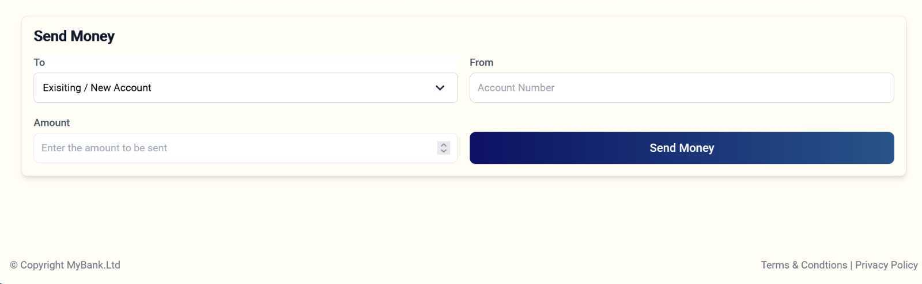
Transfer Money Component
15

Slide 30
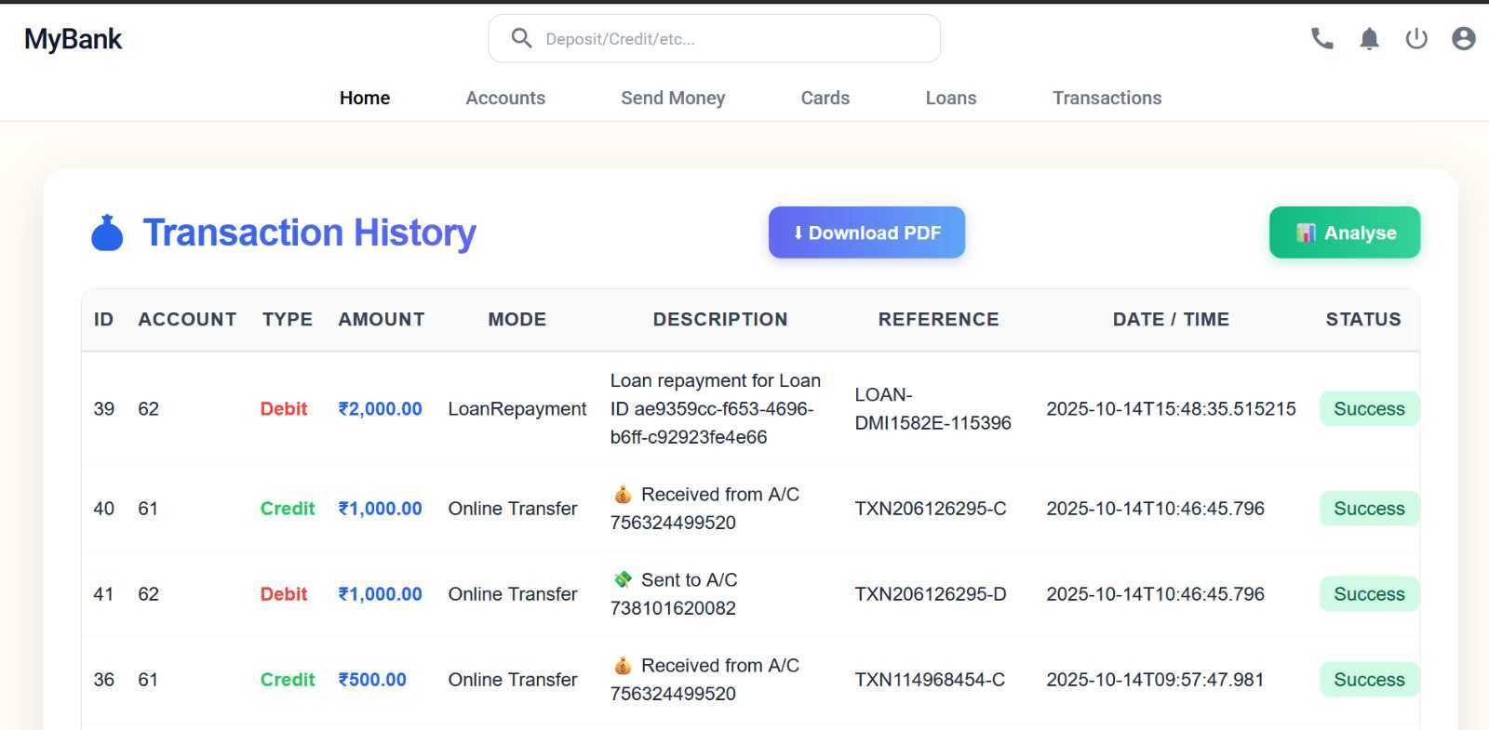
Transaction History Page
16

Slide 31
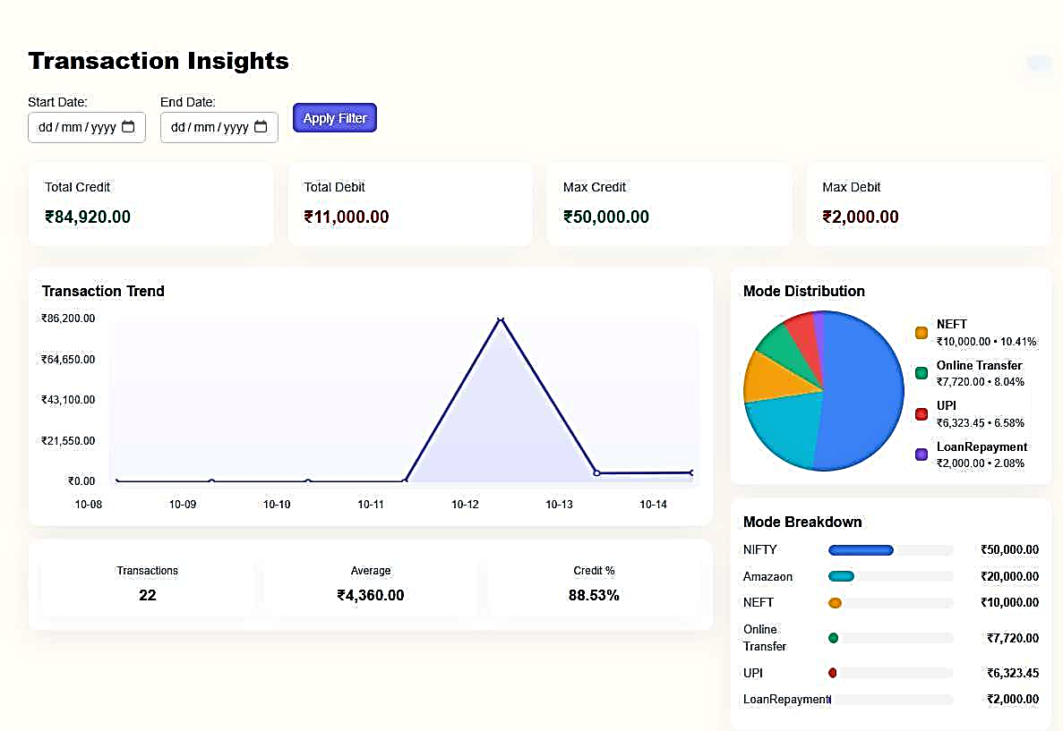
Transaction Analytics
16

Slide 32
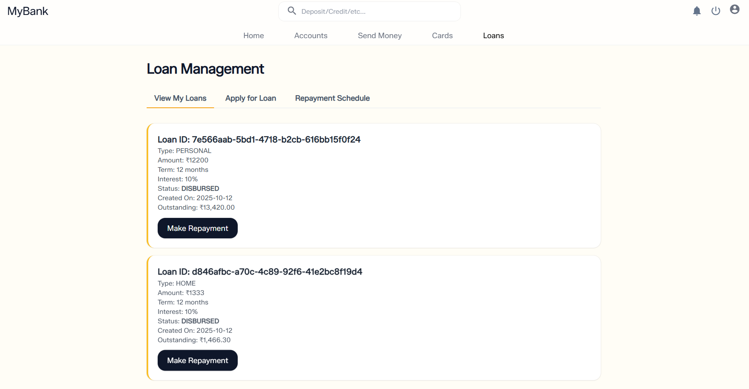
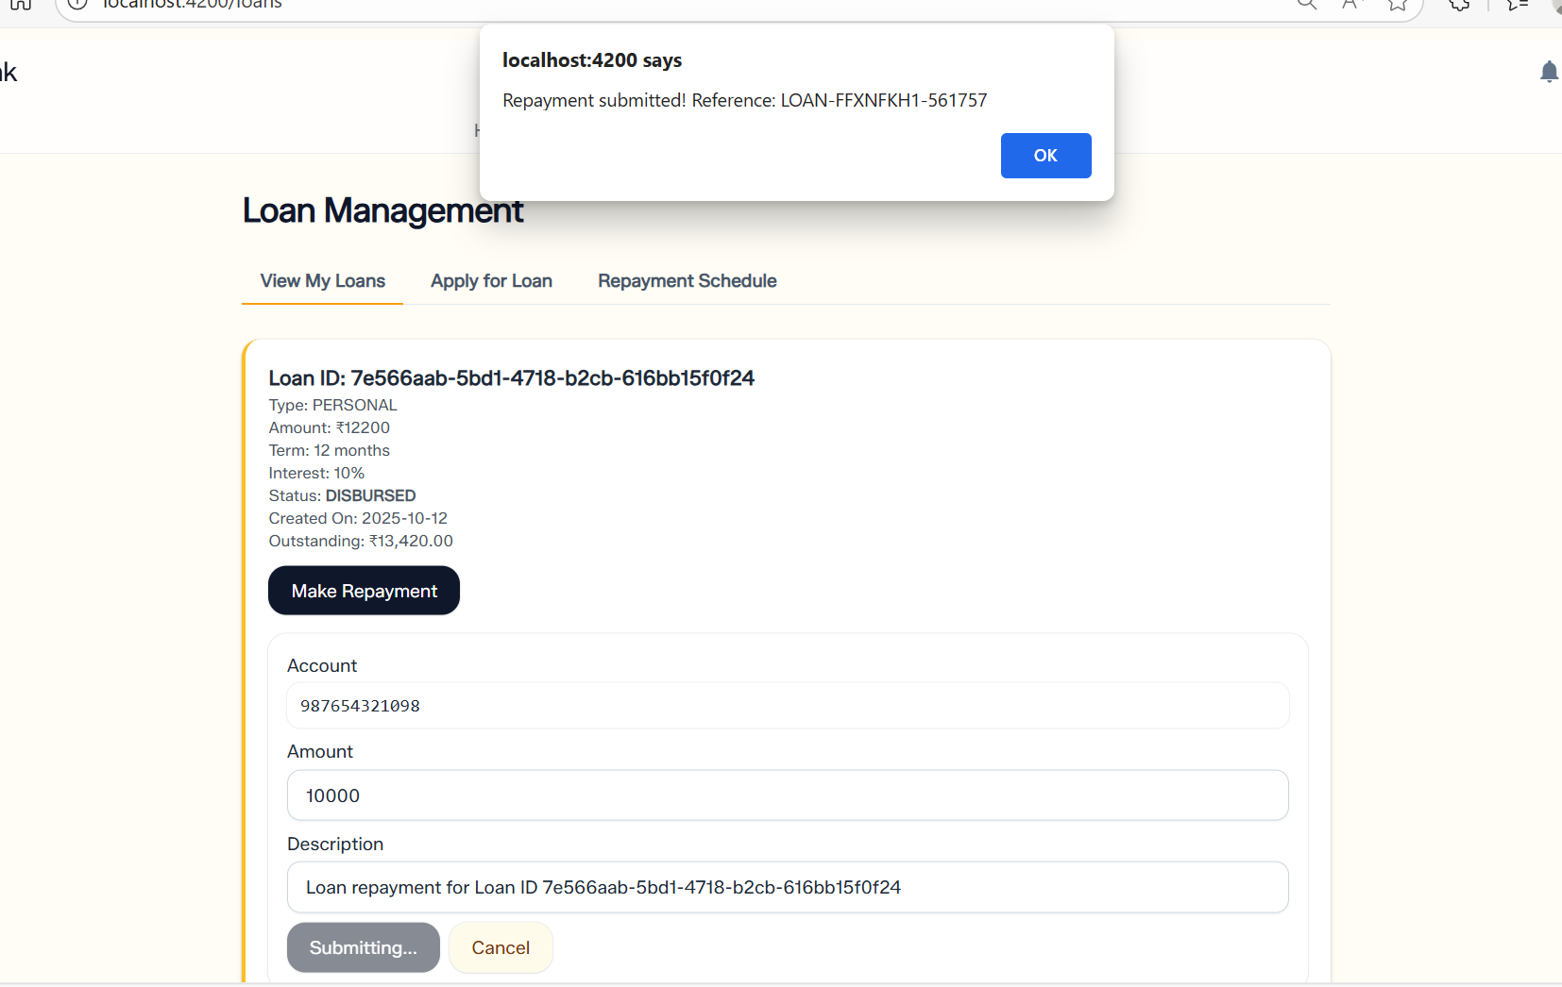
Loan Application and Repayment Page
18

Slide 33
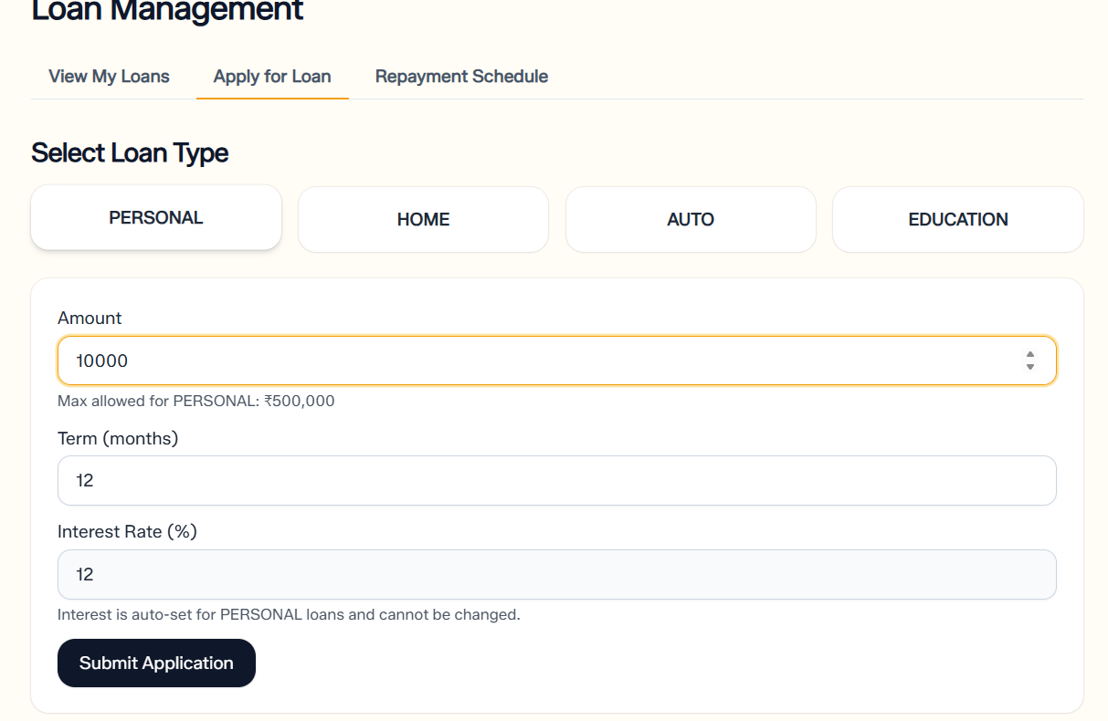
Apply for a Loan Page
18

Slide 34
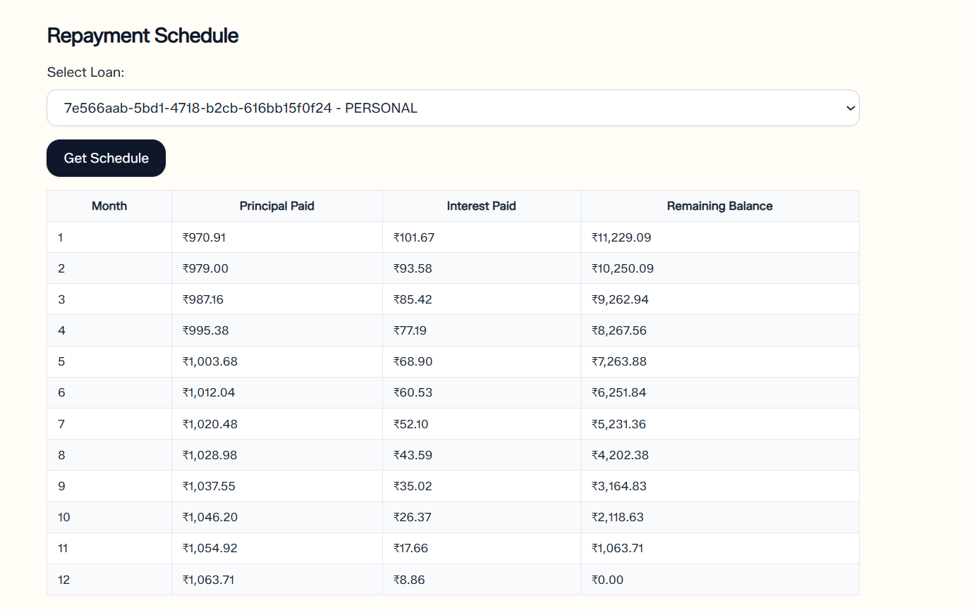
Loan Repayment Schedule Page
18

Slide 35
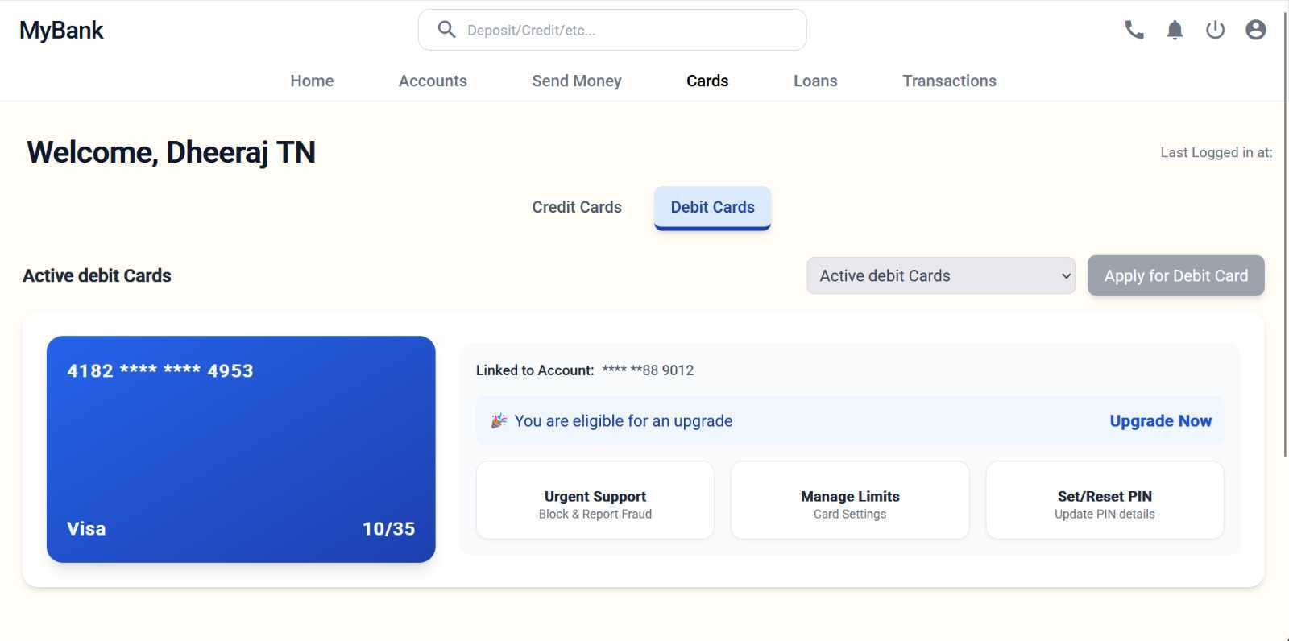
Debit Card Dashboard
16

Slide 36
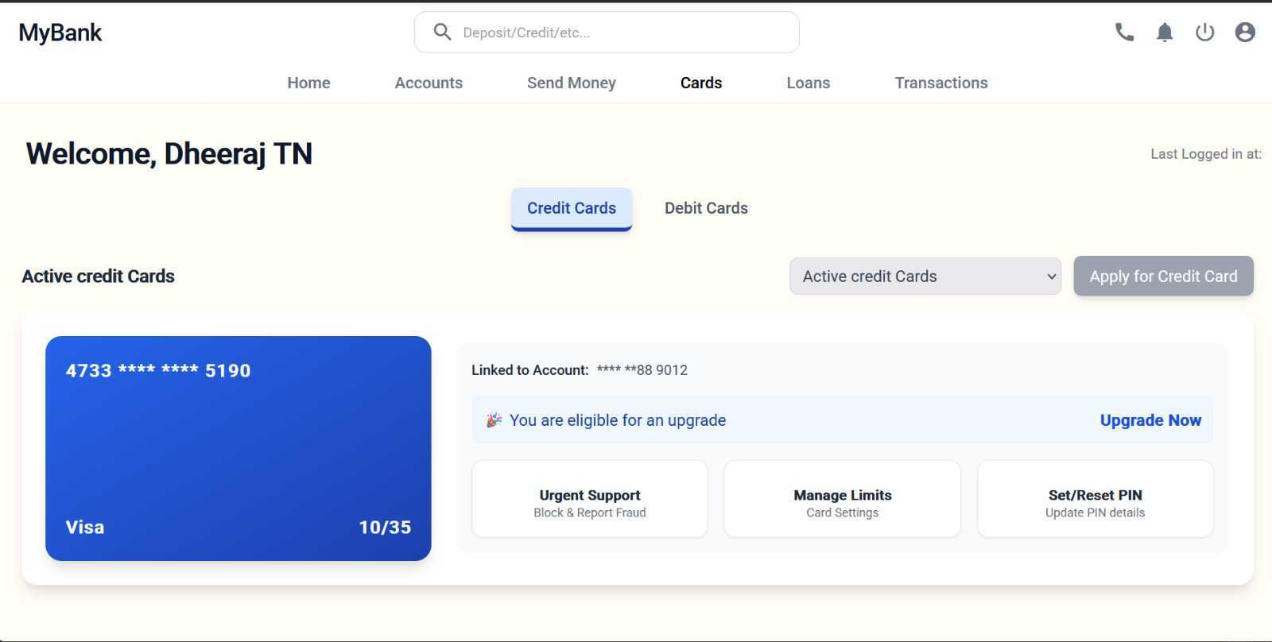
Credit Card Dashboard
16

Slide 37
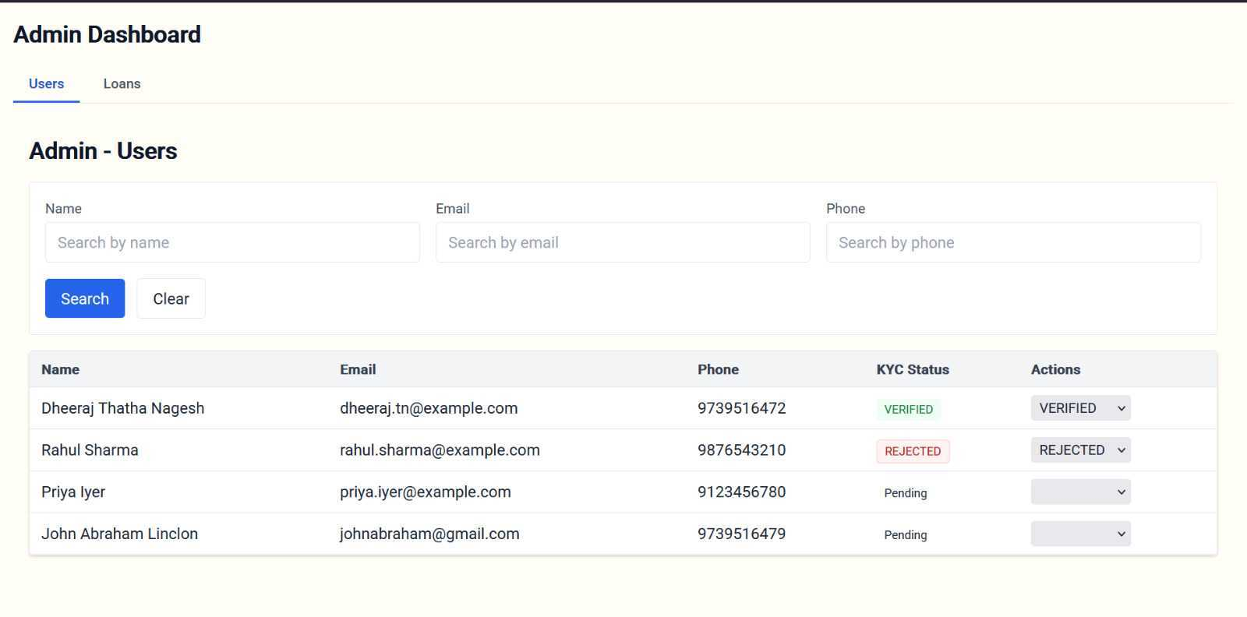
Admin Dashboard - Users
20

Slide 38
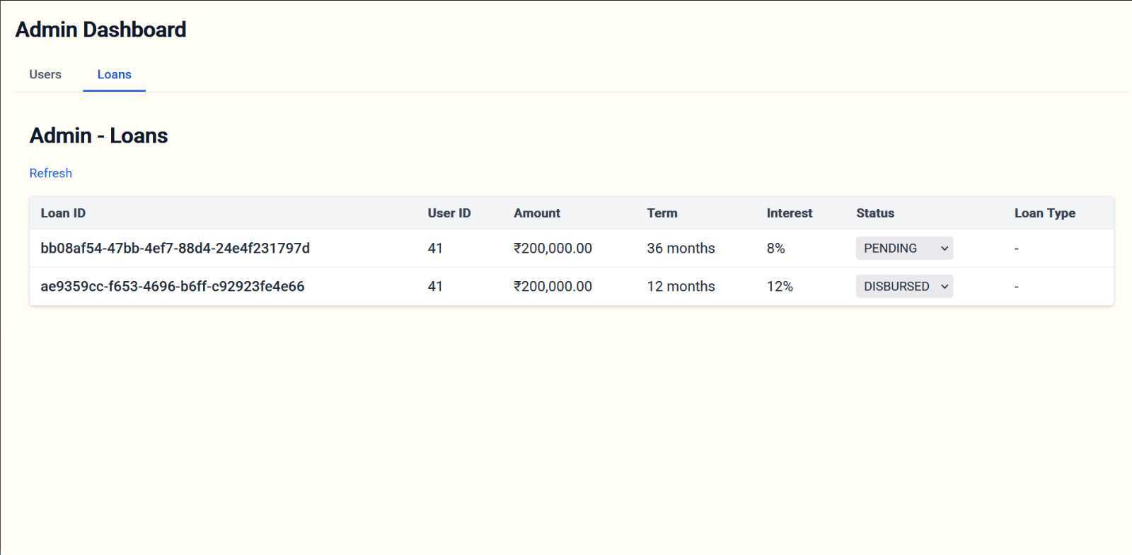
Admin Dashboard - Loans
20

Slide 39
Key Challenges & Solutions
Authentication & RBAC
Challenge: No security enforcement; roles separated only by service boundaries
Solution: Implement Spring Security + JWT; use @PreAuthorize; add API Gateway for centralized auth
No API Gateway
Challenge: Missing centralized auth, rate-limiting, CORS, logging
Solution: Introduce Spring Cloud Gateway for unified entry point and cross-cutting concerns
Data Consistency
Challenge: Repayment flow risks double-charging or partial failures
Solution: Use idempotency keys, transactional outbox/inbox or Saga patterns for reliability
24

Slide 40
Key Takeaways from This Project
Microservices architecture: Clear separation of concerns with dedicated services (loan, user, account, admin, transaction) coordinated via Eureka service discovery.
Inter-service communication: Declarative HTTP via Spring Cloud OpenFeign with client-side load balancing; aggregation pattern in loan-service (CombinedLoanUserDTO).
Persistence layer: Oracle DB across services with JPA/Hibernate and HikariCP; consistent DDL auto-update for rapid iteration.
Operations and observability: Spring Boot Actuator enabled and verbose SQL logging; Micrometer on classpath but no distributed tracing configured.
Service discovery: Netflix Eureka server and clients are first-class, enabling runtime registration and lookup; no API gateway present.
Security posture: No Spring Security/JWT/OAuth2 in code; role separation is by service boundary (admin-service endpoints vs. user/loan services), not enforced by RBAC.
24

Slide 41
Key Takeaways from This Project
Domain workflows: Loan lifecycle and repayments implemented; repayments trigger transaction-service via Feign and local event listener pattern.
Technology baseline: Java 21, Spring Boot 3.x, Spring Data JPA, Hibernate, OpenFeign, Eureka, Tomcat, Jackson, Lombok, Maven.
Developer experience: Postman collection included for manual API testing; YAML/properties configs standardized across services.
24

Slide 42
Future Scope
Introduce API Gateway (Spring Cloud Gateway) for unified entry, routing, and cross-cutting concerns.
Add authentication/authorization (Spring Security + JWT/OAuth2) with role-based access controls for admin vs. customer.
Implement resilience patterns (timeouts, retries, circuit breakers via Resilience4j) on Feign clients.
Add OpenAPI/Swagger for API documentation and client generation.
Enable distributed tracing (Sleuth/Brave + Zipkin/OTel) for cross-service observability.
24

Slide 43
Demo Links
Github Link :
24

Slide 44

THANK YOU

